Slide 1
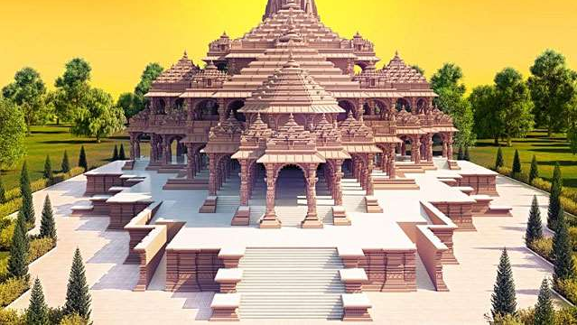
Title:
TOK Presentation
By : Raghav Verma
Controversies amidst Religion

Slide 2
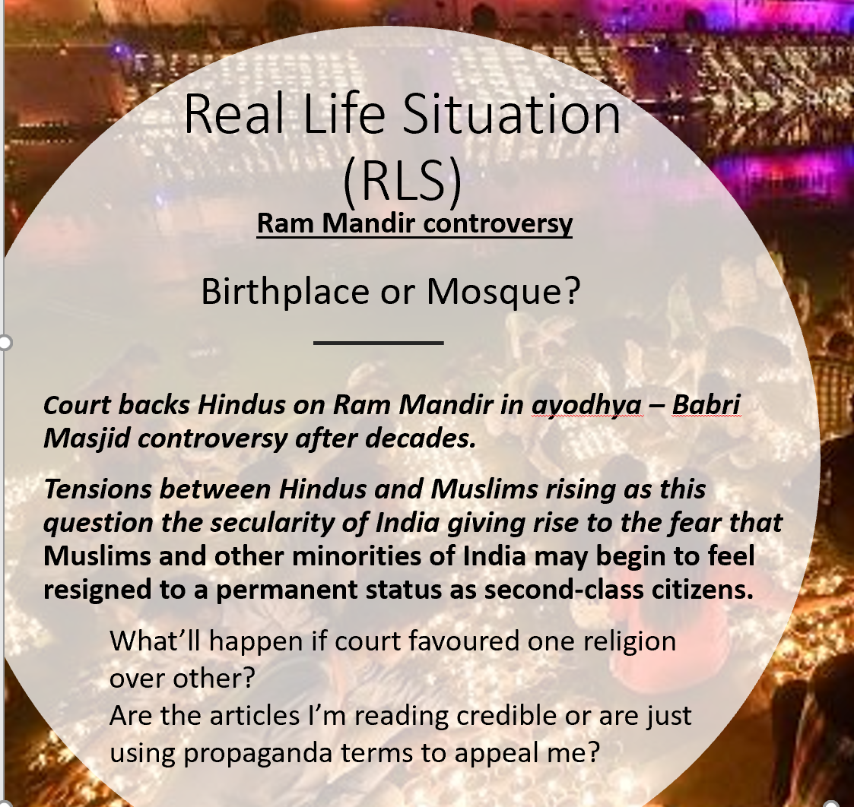
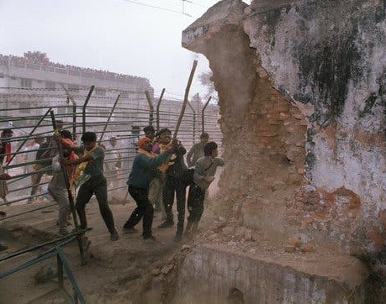
Court Backs Hindus on Ayodhya, Handing Modi Victory in His Bid to Remake India
Source of RLS article:
https://www.nytimes.com/2019/11/08/world/asia/ayodhya-supreme-court-india.html
Picture : Hindu fundamentalists attacking a wall of the Babri Mosque in 1992.Credit...Douglas E. Curran/Agence France-Presse — Getty Images

Slide 3

Knowledge Question (KQ)
What role do human-driven events play in construction of Personal and Shared knowledge?
Relation to RLS -
Human driven events – court verdict, Riots
Personal knowledge- families of those who died in riots.
Shared knowledge – Tensions between Hindus and Muslims.

Slide 4
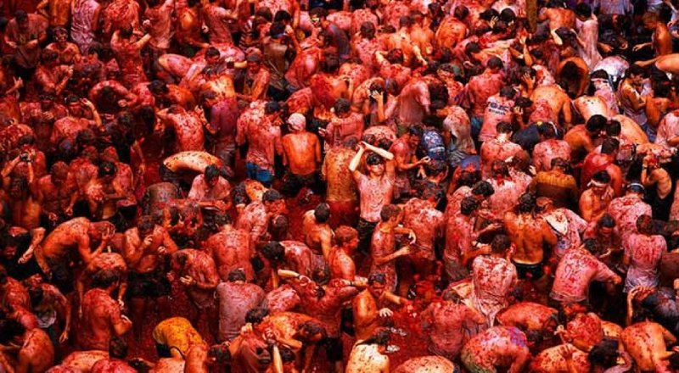
Human Scieces –-
Riots, court verdicts, witnesses and evidences. Court methodology is related to human sciences.
RKS-
Religious clashes
Value on Faith -
Methodology of RKS
Emotion -
Linking personal knowledge as it is an emotional element in religious belief.
Reason -
Methdology of Human Sciences
AOKs
WOKs
Emotion
Reason
Faith
Human Sciences
Religious Knowledge Systems
This Photo by Unknown Author is licensed under CC BY-SA

Slide 5
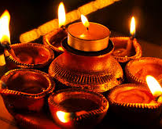
Related KQ 1
In what ways does our personal and shared beliefs affect construction of knowledge?

Slide 6
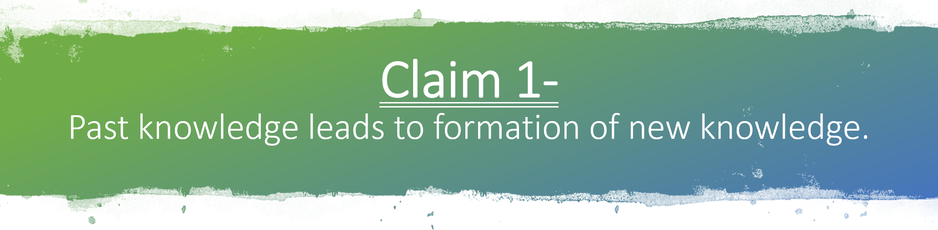
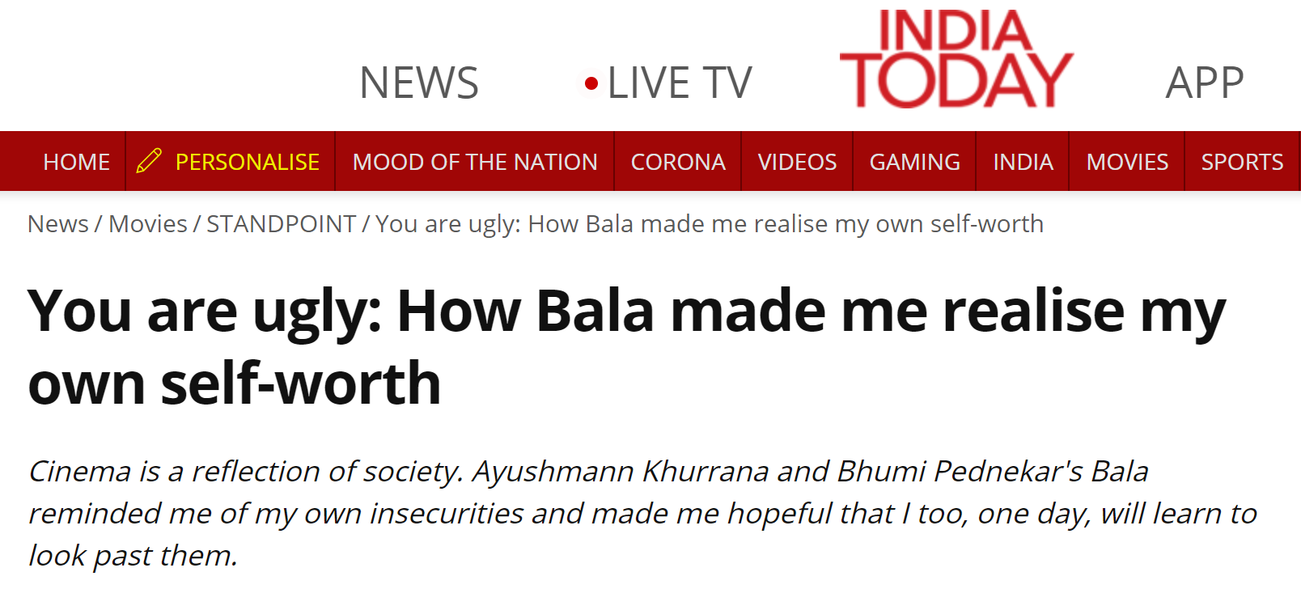
Old way of living by Hindu Vaastu is recommended in coronavirus like changing foot-wear when entering or leaving home, eating vegetarian healthy food, waking and sleeping with sun etc.
Motivation from religious leaders to stand up against society. The case in sati pratha, or everyday life where Ramayana, and Mahabharat’s examples are used in the form of allusion.
Religious texts were used by Raja Ram Mohan Roy to remove Sati Pratha.

Slide 7
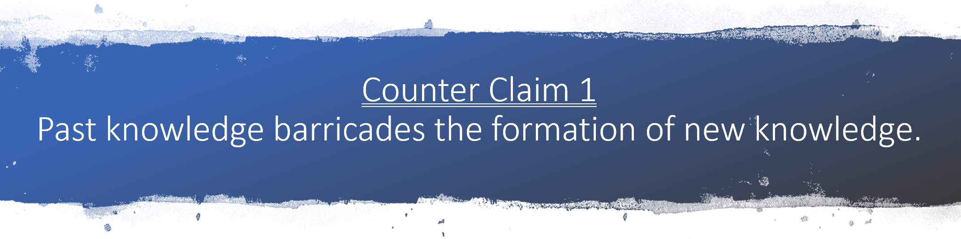
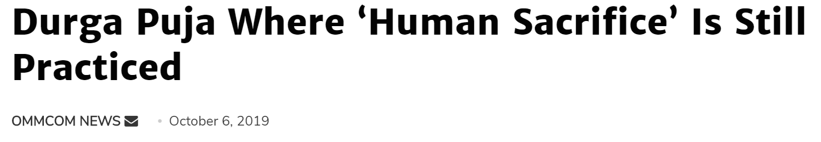
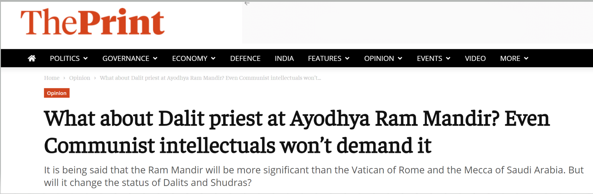
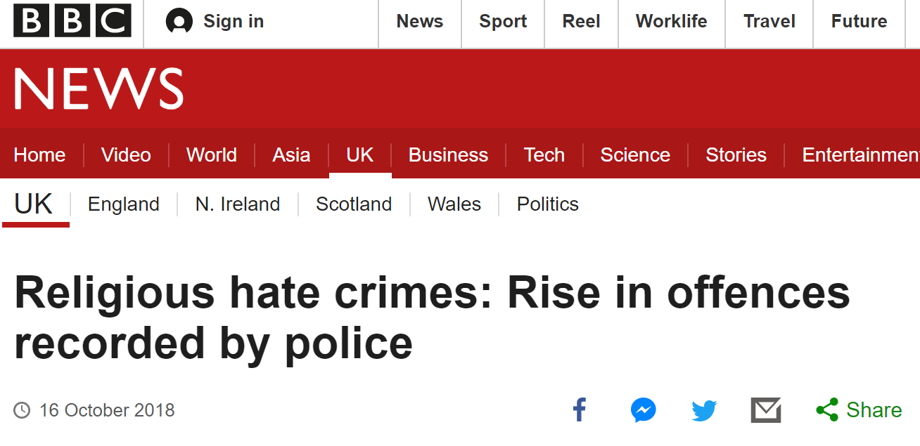
The Somatic Marker Hypothesis

Slide 8
Mini Conclusion 1
Past Knowledge is always an important part of our life as it affects most of our actions and forms the basis of thought process because of Tabula Rasa which says that humans are born without knowledge. We build up knowledge about the world as we experience it.
It’s our personal and shared beliefs which builds up our character affecting the way we react in different situations leading to formation of new knowledge and even barricading it in different human driven events and practices.
Human driven events lead to formation of knowledge but it also barricades formation of knowledge.

Slide 9
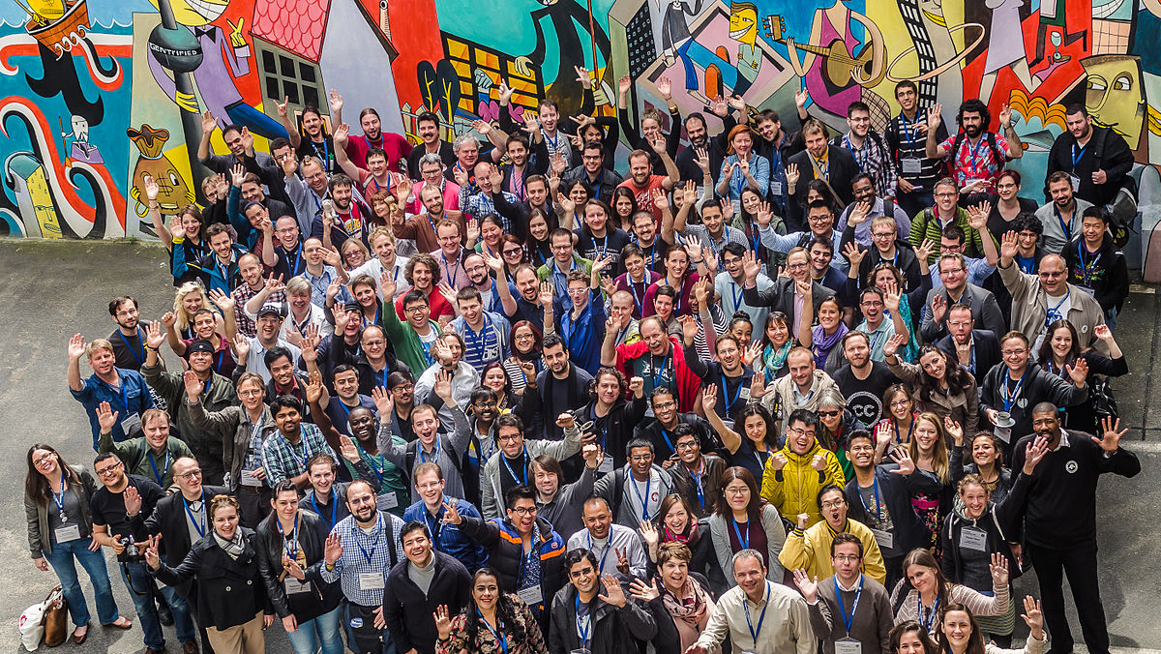

Related KQ 2
To what extent does human interpretation through confirmation bias and logical fallacy influence knowledge?
This Photo by Unknown Author is licensed under CC BY-NC-ND
This Photo by Unknown Author is licensed under CC BY-SA

Slide 10
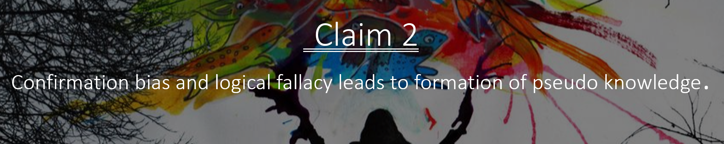
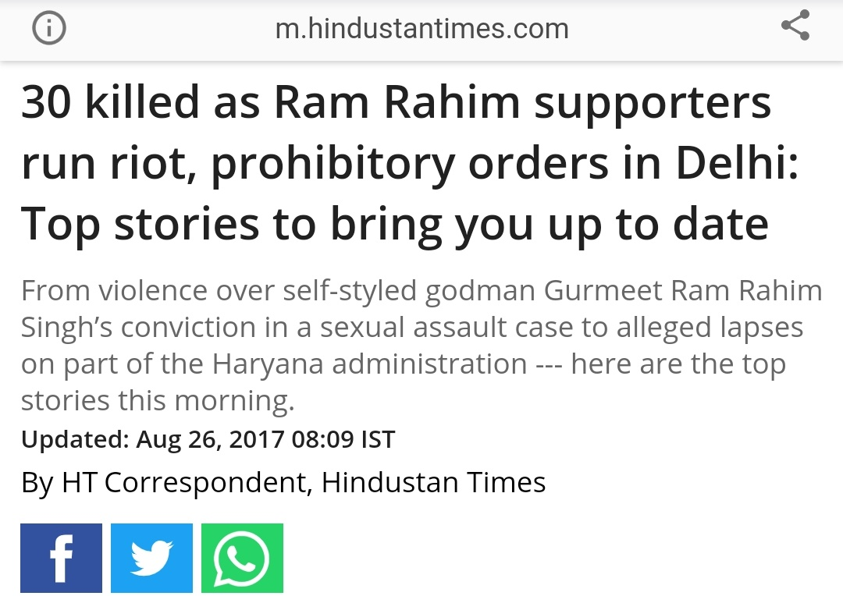
Use of propaganda techniques like name calling and card stacking often affects people’s perspectives creating knowledge or even modifying previous knowledge.
Logical fallacies appeals to individuals making them believe something which isn’t true leading to formation of new (pseudo) knowledge.
Different interpretations of ritual texts by different people.

Slide 11
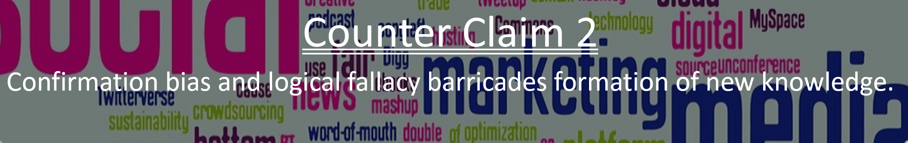
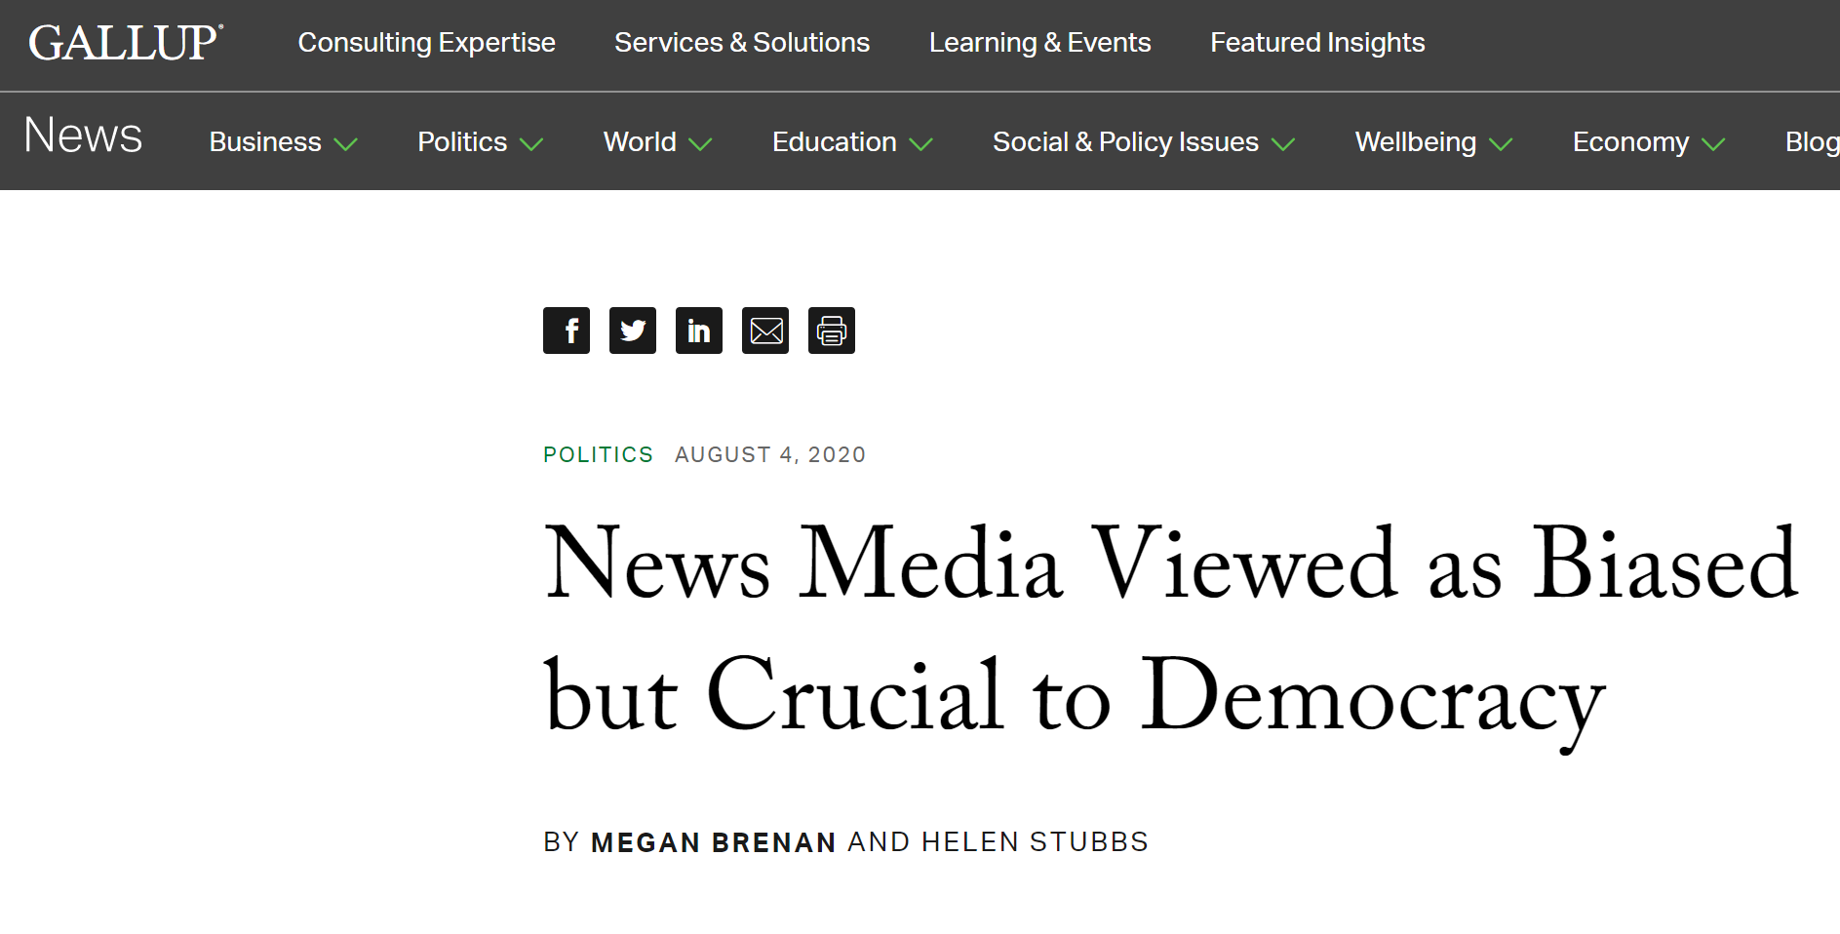
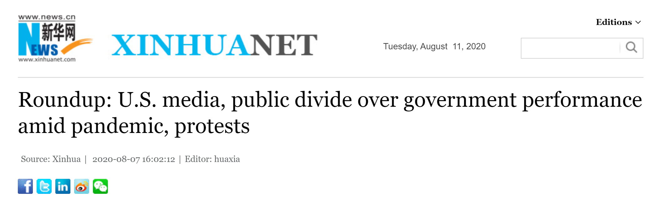
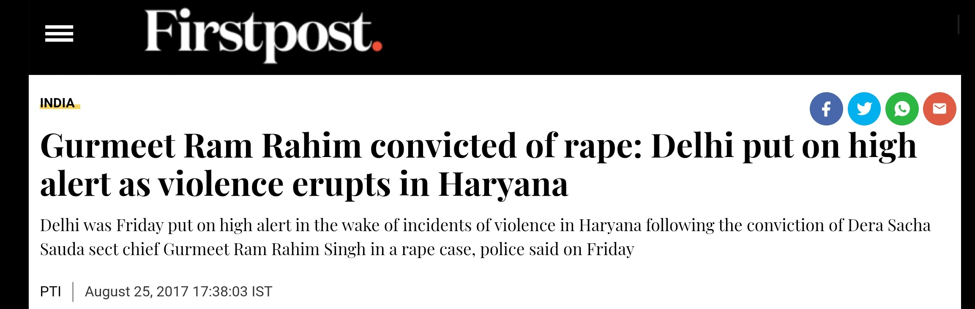
Role of Question mark at the end of newspaper headline in movie ‘Sanju’.

Slide 12

Mini Conclusion 2
As per the coherence theory of truth it is easy to believe something if it matches up to what we know, leading to confirmation bias influencing reality and leads to construction of pseudo knowledge. So Confirmation bias and fallacies generally leads to formation of pseudo knowledge, but they have the power to correct social and global issues by motivating people to think about one side of such issues by decreasing people’s clashing reasoning. Thus leading to formation of new knowledge by influencing reality using reality.

Slide 13
In religious event’s controversies, Reasoning is a better tool than emotion or faith for equitable conviction. However it’s difficult or even impossible to gather information from credible sources and witnesses in such case’s conviction. So Deductive reasoning may offer a better picture than Abductive reasoning.
Past knowledge, confirmation bias and logical fallacies affects personal and shared knowledge and beliefs, dividing and even uniting individuals and groups. But it is highly questionable if pseudo knowledge can be considered as real knowledge. (After all the methodology used in the construction of different knowledges are challenged every time and after a paradigm shift, new knowledge is constructed. Still it is difficult to prove whether that the knowledge originating after paradigm shift is pseudo knowledge or not.)
Conclusion and Significance

Slide 14
Link back to RLS
Reasoning is better to be used in our RLS than using faith or emotion as a tool in a case of national interest as ram janambhoomi-babri masjid controversy can rise tensions all over the country.
People’s interpretation and Media bias articles are filled with confirmation bias, logical fallacies and propaganda techniques like card stacking or name calling which divided 2 religions and even united the ones of same religion. All this lead to unity of Hindus who together are donating silver and money for the construction of this divine temple. In the same manner this even divided Hindus from Muslims in 1992, when people were killed in riots and Hindus attacked babri masjid.

Slide 15
Other RLS
Personal RLS :
Changing from national board to International Board, moving from urban city to metro city, moving from day boarder to boarder and that too in another city. This event of changing school in grade 11th helped me gaining new knowledge which is both personal and shared as I lived with people having similar situation like me and involves confirmation bias in choosing the right school and friends.
Other RLS :
Technological failure. Self driving Uber car that hitter and killed a jaywalking pedestrian named Elaine Herzberg. This is not the first time. Self driving cars is an upcoming global issue due to increase in self driving cars and it is difficult in court at the time of conviction because of the problem whom to blame? As a technology can’t be blamed should the owner be convicted, or the producer of technology, or government for permitting such technology to run freely or with lack of safety protocols, or someone else.

Slide 16


Bibliography
KQ 1
https://www.google.com/amp/s/www.indiatoday.in/amp/movies/standpoint/story/you-are-ugly-how-bala-made-me-realise-my-own-self-worth-1618913-2019-11-14
https://www.google.com/amp/s/m.thewire.in/article/religion/eid-ul-zuha-animal-sacrifice-islam/amp
https://ommcomnews.com/odisha-news/durga-puja-where-human-sacrifice-is-still-practiced/amp
https://www.google.com/amp/s/theprint.in/opinion/what-about-dalit-priest-at-ayodhya-ram-mandir-even-communist-intellectuals-wont-demand-it/476475/
https://www.google.com/amp/s/www.bbc.com/news/amp/uk-45874265
KQ 2
http://www.xinhuanet.com/english/2020-08/07/c_139272743.htm
https://www.google.com/amp/www.firstpost.com/india/gurmeet-ram-rahim-convicted-of-rape-delhi-put-on-high-alert-as-violence-erupts-in-haryana-3973897.html/amp
https://www.google.com/amp/s/m.hindustantimes.com/india-news/30-killed-as-ram-rahim-supporters-run-riot-prohibitory-orders-in-delhi-top-stories-to-bring-you-up-to-date/story-Rccp5bRr50YZh5v8CA4DiM_amp.html
https://news.gallup.com/poll/316574/news-media-viewed-biased-crucial-democracy.aspx

